Slide 1
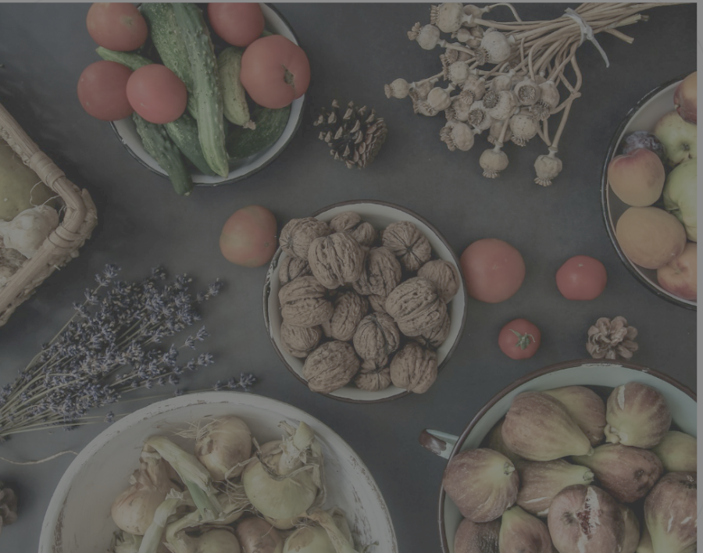
SmartKitchen.AI
AI-powered recipe suggestion from ingredient images
Kezia Kunju John
Gifty Augustine
Divya Sabu
Notes:
Hello everyone. Today, I’ll be presenting our Applied AI Lab project titled “AI-powered recipe suggestion from ingredient images.”
The goal of this project is to use artificial intelligence to look at an image of ingredients — say, what’s on your kitchen counter — and suggest suitable recipes that you can cook with those ingredients.
This project brings AI into a very practical, everyday domain: cooking.

Slide 2
Introduction & Vision
Problem Statement:
The "What's for dinner?" dilemma. Users have ingredients but lacks inspiration or knows the exact recipe names.
Notes:
Most recipe apps today expect you to type in ingredients manually, which isn’t very intuitive.
With the rise of vision-language models — or VLMs — AI can now understand both images and text.
So the idea is: you take a photo of your ingredients, and the AI recognizes them and suggests recipes.
Our goal is to make this process automatic and practical.

Slide 3
Solution
“SmartKitchen.AI”
Visual first tool bridging gap between raw ingredients and executable recipes

Slide 4
Technology Stack -01
Backend Architecture:
FastAPI: High-performance Python web framework.
Uvicorn: ASGI server for asynchronous execution.
Frontend Design:
Single Page Application (SPA): Using modern vanilla JavaScript and CSS.
Design Language: Glassmorphism, animations (Inter font, FontAwesome icons), and responsive layouts.

Slide 5
Technology Stack -02
AI Core:
QwenVL-2: A powerful Vision-Language Model tuned for ingredient recognition.
Transformers & Torch: Underlying libraries for model inference.

Slide 6
Data Engineering & Preprocessing -01
Recipe Dataset
Utilizing the Recipe1M+ dataset (1 million recipes, 13 million images).
Visual Data
Captured own images of fridge or kitchen ingredients
35 test photos with mixed raw ingredients to test model robustness on realistic, unstructured scenes
Random images from the internet.
Notes:
For data collection, we followed a hybrid approach to balance scale, realism, and practicality.
First, we used open-source datasets like ngredients Recognition Dataset (Kaggle) and Recipe1M+ — these provide a solid foundation for understanding how ingredients appear in various contexts. While these datasets mostly feature prepared dishes, they help the Vision-Language Model (VLM) recognize common ingredients and food items.
Second, we collected our own small test dataset — around 10 to 20 photos — showing real ingredients in a fridge, on a kitchen table, or counter. These images are much closer to real-world use cases and let us test how well the model generalizes beyond curated online datasets. This also helps evaluate whether the model can detect multiple ingredients in a single messy scene — something that’s common in everyday life.
Finally, for recipe data, instead of scraping websites like Chefkoch or SeriousEats, which have licensing restrictions, we built a local recipe database. It’s stored in CSV or JSON format, containing fields like recipe title, ingredient list, and cooking instructions. This local dataset allows us to experiment with recipe retrieval safely and reproducibly.

Slide 7
Data Engineering & Preprocessing -02
Processing Pipeline (clean_dataset.py):
Filtering "non-dish" items (e.g., powders, extracts).
Ingredient normalization (unit stripping, descriptor removal).
Heuristic-based cleaning to ensure high-quality matching.
Inventory Analytics (generate_glossary.py):
Frequency analysis of ingredients across 100k+ recipes.
Automatic singularization and merging of plural forms.

Slide 8
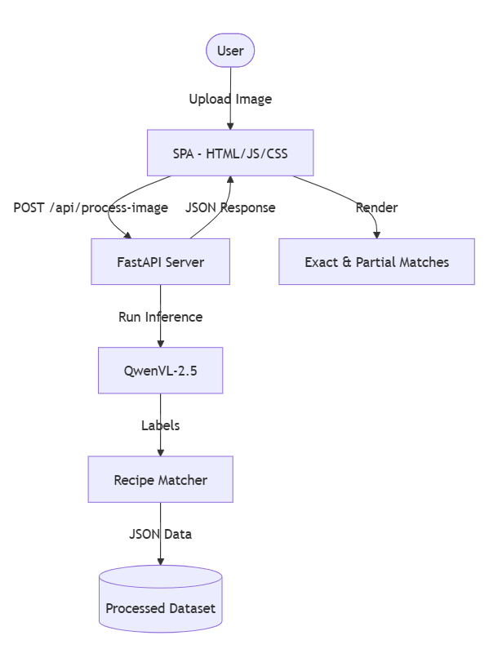
Architecture - 01

Slide 9
Architecture - 02
VLM Analysis Flow:
Image upload
Encoding
QwenVL Inference
Tag extraction.

Slide 10
The Matching Algorithm
Exact Matches: Recipes where the user has 100% of required non-staple ingredients.
Partial Matches: Ranking recipes based on "Coverage Score" (>20%) and "Missing Count".

Slide 11
Workflow - 01
Visual Capture: The user captures or uploads a photo of their kitchen counter or fridge.
Vision-Language Inference: The QwenVL-2 model parses the scene, identifying specific ingredients (e.g., "bell pepper," "chicken breast").
Semantic Normalization: Our cleaner script strips units and pluralizes/singularizes terms to ensure they match our database vocabulary (e.g., "carrots" -> "carrot").

Slide 12
Workflow - 02
4. Heuristic Filter Matching: We filter millions of recipes using a multi-tier logic.
5. Interactive Results: The frontend renders recipes with "Match Scores" and highlights "Missing Ingredients" to help the user decide.

Slide 13
Project Milestones & Work Accomplished - 01
Dataset Acquisition & Research
Identified and integrated the Recipe1M+ dataset as our primary source.
2. Intelligent Pre-processing
Cleaning: Developed clean_dataset.py to strip noisy descriptors (e.g., 'chopped', 'fresh') and non-food items.
Glossary Engineering: Built an automated ingredient registry with plural-merging logic to ensure semantic consistency.

Slide 14
Project Milestones & Work Accomplished - 02
3. VLM Evaluation & Selection
Benchmarking: Evaluated multiple Vision-Language Models for ingredient recognition accuracy.
Optimization: Selected QwenVL-2 for its superior performance in identifying raw food items across diverse kitchen settings.

Slide 15
Project Milestones & Work Accomplished - 03
4. SmartKitchen.AI Implementation
Backend: Created a fast backend using FastAPI for handling VLM inference.
Frontend: Built a simple, modern UI with a glassmorphism design for easy interaction.
Logic: Implemented the weighted "Exact vs. Partial" matching algorithm.

Slide 16
Evaluation Strategy
Since this is a practical AI project, evaluation is partly qualitative:
Evaluation Aspect | Metric / Method
Ingredient detection | Precision, recall, F1
Retrieval Testing | Overlap between detected and recipe ingredients
Notes:
To assess how well our system performs, we’ll evaluate it on three main aspects: ingredient detection, recipe matching, and recipe diversity.
First, for ingredient detection, we’ll measure how accurately the Vision-Language Model identifies ingredients from the image. The standard metrics we’ll use here are precision, recall, and F1-score —
Precision tells us how many of the detected ingredients are actually correct,
Recall measures how many of the real ingredients were successfully detected, and
F1-score balances both. This gives a solid quantitative measure of how good the model is at visual recognition.
Second, for recipe matching, we’ll check how well the detected ingredients overlap with the ingredients listed in the suggested recipe. In other words, if the model detects tomato, garlic, and basil, and the recipe also includes those ingredients, the match quality is high. We can compute this overlap as a simple ratio or similarity score.
Finally, for recipe diversity, we’ll look at how varied the recipe suggestions are — for instance, whether the system always suggests similar dishes or covers a wide range of cuisines and meal types. We can track this by counting the number of unique recipe types suggested across different inputs.
Together, these three evaluation dimensions help us understand both the technical accuracy and the practical usefulness of our AI cooking assistant.

Slide 17
Results : Qwen Model Comparison
Model | Precision | Recall | F1 Score
qwen/qwen3-vl-8b-instruct | 0.630 | 0.672 | 0.647
qwen/qwen3-vl-30b-a3b-instruct | 0.662 | 0.726 | 0.687
qwen/qwen2.5-vl-32b-instruct | 0.606 | 0.702 | 0.645
qwen/qwen2.5-vl-72b-instruct | 0.636 | 0.691 | 0.654
qwen/qwen3-vl-30b-a3b-thinking | 0.695 | 0.749 | 0.716
qwen/qwen-2-vl-2b-instruct | 0.568 | 0.534 | 0.540
qwen/qwen3-vl-8b-thinking | 0.659 | 0.721 | 0.686

Slide 18
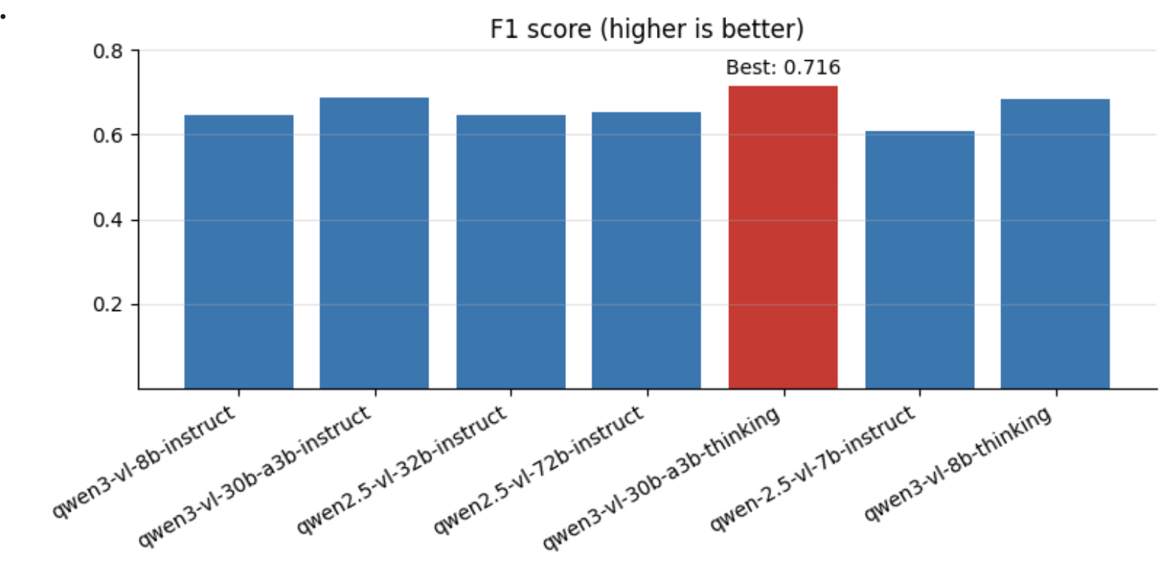

Final model choice for deployment
We built the website using Qwen 2 (VL) for ingredient understanding + generation.
Even though a Qwen3-VL model had the best F1 score during the test , we choose a Qwen2VL for the final system based on deployment practicality (latency, stability and availability).

Slide 19
Challenges
Scaling Challenges: Transitioning from JSON-based matching to SQLite FTS5 for million-record lookups.
DevOps/Deployment: Handling port conflicts (8000 vs 8001 vs 8002) and path robustness on Windows systems.
3. Poor-quality or cluttered images from user
4. Images may include personal or identifiable items
5. Ingredient names vary by language or region

Slide 20
Demo!!

Slide 21
References
Qwen2-VL Model: https://huggingface.co/Qwen/Qwen2-VL-2B-Instruct
OpenRouter API: https://openrouter.ai
Datasets:Recipe1M+, Kaggle

Slide 22
THANK YOU!

